Slide 1


MapMyWiFi
Barsa & Yamato

Slide 2


Slide 3

Topics Covered
Overview of Our App
Agenda
Key Functionallity & Features
Demo Walkthorugh
Future Plan and Conclusion

Slide 4

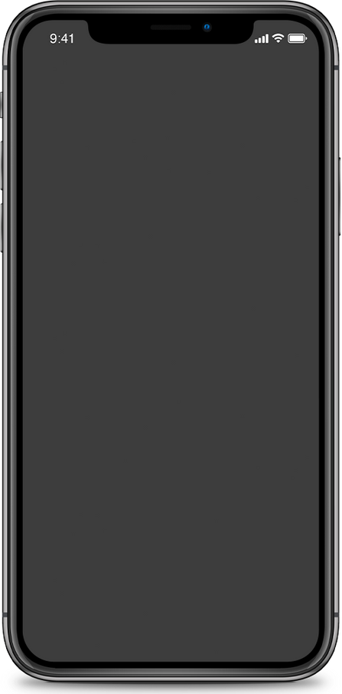
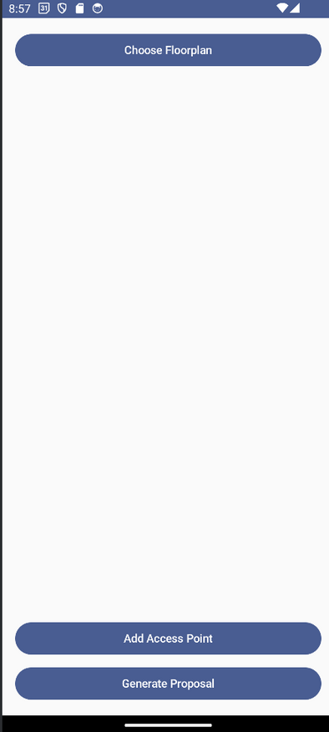
App Overview
Chosing your Floormap
Select your downloaded plan in your local
Inputting measurement
Prompt user to put the scale of their floorplan
Adding AccessPoint
Choose AP from options embedded in DB
Generating Proposal
Have options to close or share files to others

Slide 5
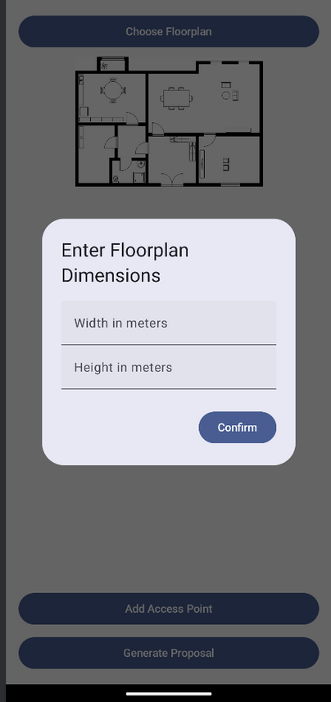
App Overview
Chosing your Floormap
Select your downloaded plan in your local
Inputting measurement
Prompt user to put the scale of their floorplan
Adding AccessPoint
Choose AP from options embedded in DB
Generating Proposal
Have options to close or share files to others

Slide 6
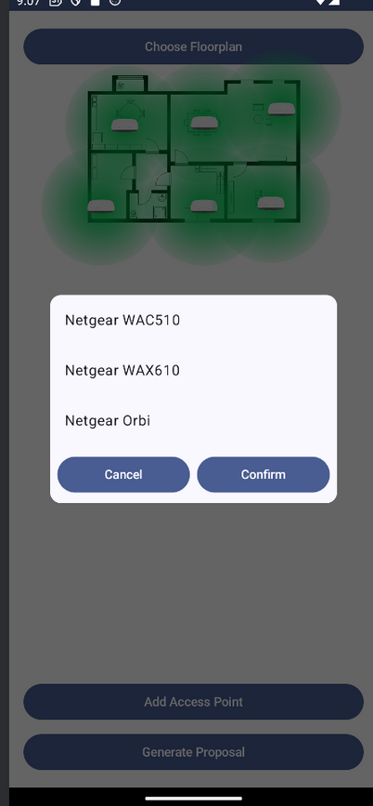
App Overview
Chosing your Floormap
Select your downloaded plan in your local
Inputting measurement
Prompt user to put the scale of their floorplan
Adding AccessPoint
Choose AP from options embedded in DB
Generating Proposal
Have options to close or share files to others

Slide 7
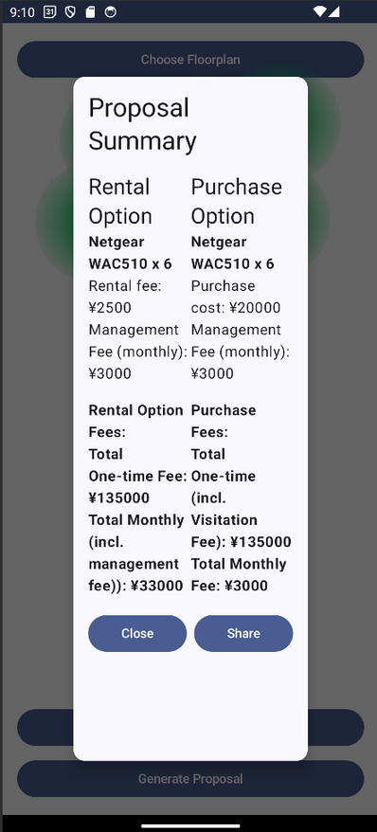
App Overview
Chosing your Floormap
Select your downloaded plan in your local
Inputting measurement
Prompt user to put the scale of their floorplan
Adding AccessPoint
Choose AP from options embedded in DB
Generating Proposal
Have options to close or share files to others

Slide 8
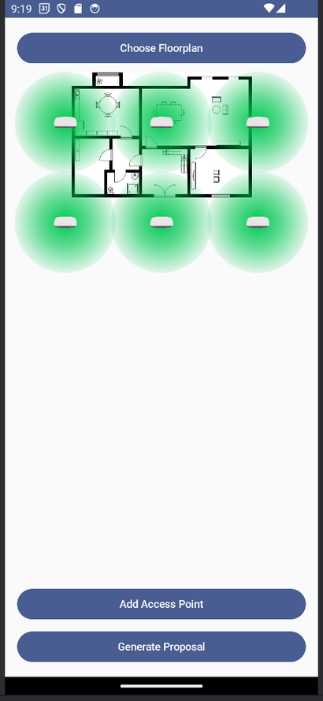

User Experience & Feedback
Plotting Adjustment
Selection of AP
Formatting of proposal
Plotted outside of the grid
Want to select multiple Access Point
+/- sign to change the number of AP
Adjusted invoice type or other font

Slide 9
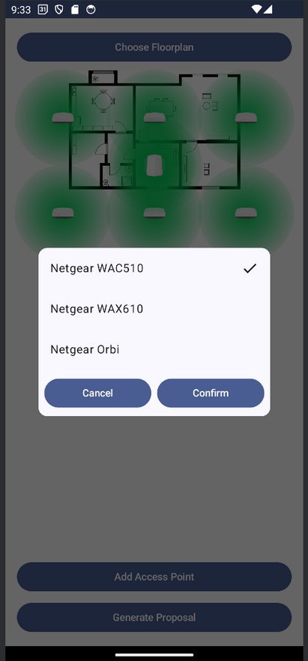
User Experience & Feedback
Plotting Adjustment
Selection of AP
Formatting of proposal
Plotted outside of the grid
Want to select multiple Access Point
+/- sign to change the number of AP
Adjusted invoice type or other font

Slide 10
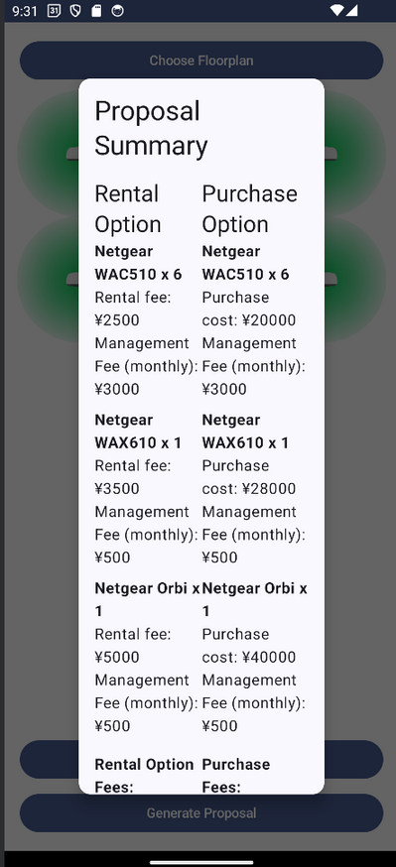
User Experience & Feedback
Plotting Adjustment
Selection of AP
Formatting of proposal
Plotted outside of the grid
Want to select multiple Access Point
+/- sign to change the number of AP
Proposal is a little hard to see within this windows

Slide 11
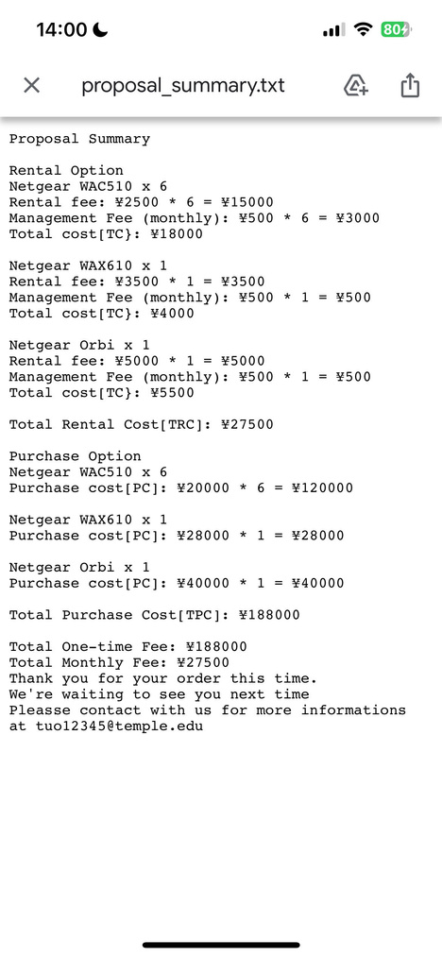
User Experience & Feedback
Plotting Adjustment
Selection of AP
Proposal Layout
Plotted outside of the grid
Want to select multiple Access Point
+/- sign to change the number of AP
Text only seems a little hard to see
Maybe could use different format, letter size

Slide 12
Future Plan
Plotting Adjustment
Selection of AP
Formatting of proposal
Wall detection using CNN
Want to select multiple Access Point
+/- sign to change the number of AP
Adjusted invoice type or other font

Slide 13
Future Plan
BEST PLACEMENT
Formatting of proposal
Plotting Adjustment
Wall detection using CNN
Greedy algorithm
Genetic algorithm
Simulated Annealing
Adjusted invoice type or other font

Slide 14
Future Plan
Formatting of proposal
Including images of the floor plan and well formated & different file types like PDF and .docs

Slide 15
Q&A

